Slide 1
Intro to Databases

Slide 2
Where are we going...
Web page structure and appearance with HTML5 and CSS.
Client-side interactivity with JS DOM and events.
Using web services (API's) as a client with JS.
Writing JSON-based web services with a server-side language.
Storing and retrieving information in a database with SQL and server-side programs.

Slide 3
Introduction to Databases

Slide 4
What is a Database?
A collection of related information, similar to JSON (but more tabular)
What are some examples of data you could store in a database?
Pokedex
Book Reviews
Store Inventory
User Information
Movies/Games
Cafe Menu
...

Slide 5
Why Learn Databases in this Class?
Databases give us a great improvement in the way we can build, process, and retrieve large datasets. Most software companies will have a large group dedicated to database management.
Advantages of a database:
Powerful: Can search it, filter data, combine data from multiple sources.
Fast: Can search/filter a database very quickly compared to a file/JSON.
Big: Scale well up to very large data sizes.
Safe: Built-in mechanisms for failure recovery (e.g. transactions).
Multi-user: Concurrency feature let many users view/edit data at the same time.
Abstract: Provides layer of abstraction between stored data and app(s) - many database programs understand the same commands.

Slide 6
Database Software
Oracle
Microsoft SQL Server (powerful) and Microsoft Access (simple)
PostgreSQL (powerful/complex free open-source database system)
SQLite (transportable, lightweight free open-source database system)
MySQL (simple free open-source database system)
Types of databases not covered in our course:
NoSQL
Key/Value
Blob/Document
GraphQL
HBase, distributed databases

Slide 7
Relational Database vs. Others
Many different ways to store data (see previous slide)
Relational databases define tabular data (data stored in tables), with operations that allow you to relate them to each other.
Modern RDBMSs (Relational DataBase Management System) are transactional.
This allows the database to ensure that certain expectations about your data are met.
Each transaction is made up of 1+ commands

Slide 8
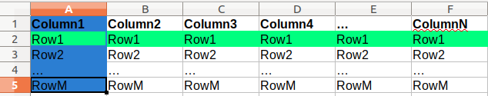
A Relational Database
Relational Database: A method of structuring data as tables associated by shared attributes
A table row corresponds to a unit of data called a record; a column corresponds to an attribute of that record
In Excel-speak:
In the above image, the cells highlighted blue are the first "column" and the cells highlighted green are of the first "row" (or "record", or "tuple")
Tables can be visualized just like an Excel sheet, just with different terminology, and more programmatic capabilities.

Slide 9
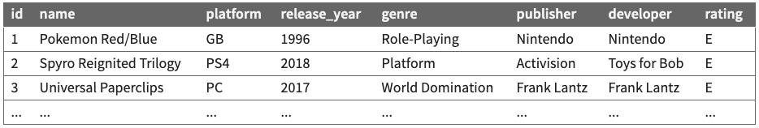
Example Database

Slide 10
Structured Query Language (SQL)
A "domain-specific language" (HTML is also a DSL) designed specifically for data access and management.
Also like HTML, SQL is a declarative language: describes what data you are seeking, not exactly how to find it.
In SQL, you write statements. The main different types of statements we'll look at:
Data Definition: Generally, what does your data look like?
Data Manipulation: Change or access the data.
(There are others, but we won't be talking about them.)

Slide 11
Today starts our intro to SQL
function filterJSON(pokemonJSON) {
let pokemon = pokemonJSON["pokemon"];
let filtered = [];
for (let i = 0; i < pokemon.length; i++) {
let data = pokemon[i];
if (data.weakness === "rock" && data.name.indexOf("r") !== -1 && data.id < 145) {
filtered.push({
"name": data.name, "type": data.type,
"id": data.id, "weakness": data.weakness
});
}
}
}
The following code does everything above without JSON/JS!
SELECT name, id, type, weakness
FROM pokemon
WHERE id < 145 AND name LIKE '%a%' AND weakness = 'rock'
ORDER BY type, name DESC;

Slide 12
A Preview to Node.js + SQL
let qry = "SELECT name, id, type, weakness FROM pokedex " +
"WHERE name LIKE '%r%' AND id < 145 AND weakness = 'rock' " +
"ORDER BY type, name DESC";
let rows = await db.all(filterQuery);
console.log(JSON.stringify(rows));
// [{"name":"Articuno","id":144,"type":"ice","weakness":"rock"}]

Slide 13
Querying for rows using .all
Executing a statement using .run
We can use the .all function to get an array of rows returned by the passed query.
let db = await getDBConnection();
let ex1 = await db.all('SELECT * FROM cafe');
let ex2 = await db.all('SELECT * FROM cafe WHERE price = ?', '5');
The run function executes a single SQL query
let db = await getDbConnection();
let sql = 'INSERT INTO pokedex (name, type) VALUES (?, ?)';
await db.run(sql, ['Bulbasaur', 'grass']);

Slide 14
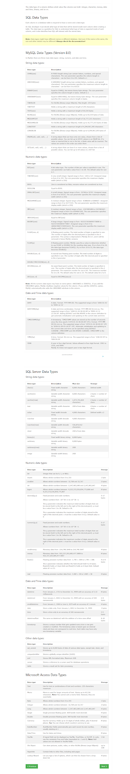
Types in SQLite
SQLite (sort of like JavaScript) has a lot of built-in flexibility.
It only actually has 5 data types:
NULL -- like in JavaScript, stands for the absence of value
INTEGER -- whole numbers (e.g., -3, -2, -1, 0, 1, 2, 3, 4, etc.)
REAL -- decimal numbers (e.g., 3.141592653589)
TEXT -- strings
BLOB -- everything else
However: If you look up "SQL data types" on The Internet™ you'll find pages and page of different types

Slide 15
SQLite uses dynamic typing
Declaring variables in JavaScript: var, let, const.
Declaring variables in Java: int, String, double, Point, etc.
Dynamic
Static

Slide 16
SQLite uses dynamic typing
Declaring variables in JavaScript: var, let, const.
Declaring variables in Java: int, String, double, Point, etc.
Dynamic
Static
Declaring columns in SQLite: INTEGER, TEXT, etc.
Declaring columns in just about every other SQL (relational) DB: ....
Dynamic
Static

Slide 17
SQL Data Types
The following are commonly used static SQL types:
Type | Argument | Description
INT | none | An integer number
VARCHAR(n) | The string can be at most n characters (max of 65,535). | A text string
TINYINT | none | Stores only very small numbers (definition of "small" varies, but is usually between 0 and 255)
DATETIME | none | Stores dates and times for precise time information: YYYY-MM-DD HH:MM:SS
DOUBLE | Optionally (m,d), specifying how many digits in the number. | A decimal number. Rounds based on the provided precision.
TEXT | none | A potentially very large text string.

Slide 18
Conversion to SQLite
Static SQL Type | SQLite Type
INT | INTEGER
VARCHAR(n) | TEXT
TINYINT | INTEGER
DATETIME | NUMERIC
DOUBLE | REAL
TEXT | TEXT

Slide 19
Conversion to SQLite
Static SQL Type | SQLite Type
INT | INTEGER
VARCHAR(n) | TEXT
TINYINT | INTEGER
DATETIME | NUMERIC
DOUBLE | REAL
TEXT | TEXT
SQLite has this special value classification for things you might want to have handled specially.
These include:
Dates
Booleans
"Strings"

Slide 20
CREATE TABLE: Syntax
WHAT IS THIS?!?!
CREATE TABLE table_name(
column1 datatype PRIMARY KEY,
column2 datatype,
column3 datatype,
.....
columnN datatype
);

Slide 21
Useful Column Constraints
The following are very common and useful in CREATE TABLE statements.
These are called constraints - they "constrain" the types of values you can insert in a column.
This reading on constraints is an excellent overview for more details.
PRIMARY KEY (keyname): Used to specify a column or group of columns uniquely identifies a row in a table.
AUTOINCREMENT: Used with the primary key column to automatically generate the "next" value for the key. In SQLite, only available for the primary key.
NOT NULL: prevents NULL entries in a column, requires the value to be set in INSERT statements.
DEFAULT: specifies default values for a column if not provided in an INSERT statement
UNIQUE: requires an attribute to be unique (useful for fields that are not PRIMARY KEY but should still be unique)

Slide 22
Extracting the data
Every table should have a column which is used to uniquely identify each row. This improves efficiency and will prove very useful when using multiple tables.
CREATE TABLE students(
id INTEGER PRIMARY KEY AUTOINCREMENT,
name TEXT NOT NULL,
username TEXT NOT NULL UNIQUE,
email TEXT NOT NULL
);
Adding PRIMARY KEY makes it so that the code will error if that column ever has duplicates. It will use that column to identify each row quickly. This is usually an integer id, but can also be other types. Conventionally named id.
AUTOINCREMENT will make it so that if you provide no input for that column, it will pick the highest unused value. Perfect for making it so you don't have to worry about what the next id is.

Slide 23
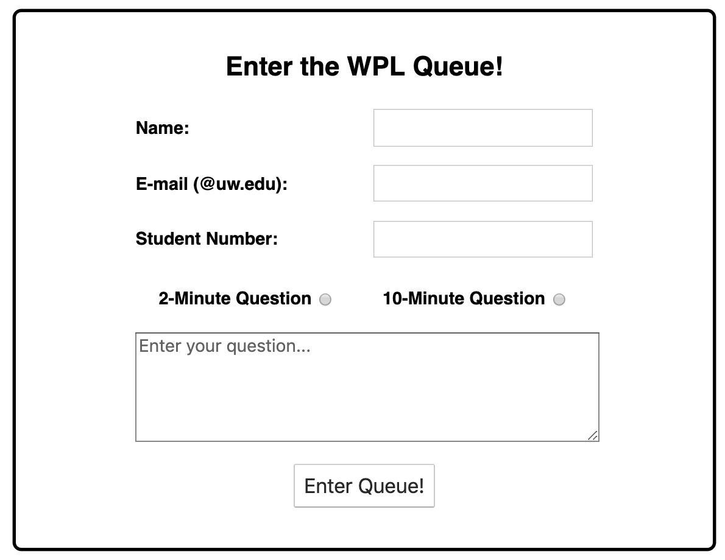
Remember the WPL Queue?
We introduced the WPL queue to teach Forms and validation on the client-side. What types of data might we want to store in a database (wpl.db) for the WPL Queue?
Text-based
The name of the student
The email address
The question text
But what about...
The student number (this could also be text)
The question length (2 or 10)
A unique identifier for each question
When the question was submitted

Slide 24
CREATE TABLE: example
What would the CREATE TABLE SQL command look like to create a table to hold the queue for the WPL example?
CREATE TABLE queue(
id INTEGER PRIMARY KEY AUTOINCREMENT,
name TEXT,
email TEXT,
student_id INTEGER,
length INTEGER,
question TEXT,
creation_time DATETIME DEFAULT CURRENT_TIMESTAMP
);

